Slide 1

Don't put your messages in a bottle
Implement messaging patterns

Slide 2




Introduction
Olena Borzenko
Xpirit
Celestial Programmer / CDO (Chief Drinking Officer)
Azure MVP
@borzenko_lena
Eldert Grootenboer
Microsoft
Program Manager Azure Service Bus
@egrootenboer
Notes:
O & E

Slide 3

Speaker Bio
Eldert Grootenboer
He/Him
Program Manager - Azure Service Bus
@egrootenboer
egrootenboer@microsoft.com

Slide 4









Azure Messaging Platform Messages vs. events
AMQP
JMS
Queue Pub/Sub Broker
Pull-style, queue-based transfer of jobs and control via message queues and topics
Azure Service Bus
Partitioned, high-volume, tape-drive-style sequential recording and unlimited, pull-style re-reads of event streams.
Event Stream Engine
Azure Event Hubs
Push-style distribution of discrete events to serverless workloads or other messaging infrastructures
Discrete Event Router
Azure Event Grid
Event Stream Aggregator
Stateful transformation and analytics of event streams yielding event streams and discrete events as continuous output
Azure Stream Analytics

Slide 5

Azure Messaging Platform Messages vs. events
AMQP
JMS
Queue Pub/Sub Broker
Pull-style, queue-based transfer of jobs and control via message queues and topics
Azure Service Bus
Partitioned, high-volume, tape-drive-style sequential recording and unlimited, pull-style re-reads of event streams.
Event Stream Engine
Azure Event Hubs
Push-style distribution of discrete events to serverless workloads or other messaging infrastructures
Discrete Event Router
Azure Event Grid
Event Stream Aggregator
Stateful transformation and analytics of event streams yielding event streams and discrete events as continuous output
Azure Stream Analytics

Slide 6


Join at slido.com #5618365
ⓘ Start presenting to display the joining instructions on this slide.

Slide 7

How much experience do you have with Azure Service Bus
ⓘ Start presenting to display the poll results on this slide.

Slide 8

Which patterns would you like to see today?
ⓘ Start presenting to display the poll results on this slide.

Slide 9

Messaging Patterns

Slide 10
What are messaging patterns
Recurring scenarios
Abstract
Reusable
Notes:
Patterns are accepted solutions to recurring problems within a given context.
They are abstract enough to apply to most integration technologies, but specific enough to provide hands-on guidance to designers and architects.
Patterns also provide a vocabulary for developers to efficiently describe their solution.
2

Slide 11
Why use messaging patterns
Don’t reinvent the wheel
Use experts’ experience
Standards
Notes:
3

Slide 12

Competing Consumers
https://docs.microsoft.com/en-us/azure/architecture/patterns/competing-consumers

Slide 13
Competing Consumers

Slide 14

Competing Consumers

Slide 15
Competing Consumers
Notes:
->

Slide 16
Competing Consumers

Slide 17
Competing Consumers

Slide 18
Competing Consumers

Slide 19
Competing Consumers
Notes:
->

Slide 20
Competing Consumers

Slide 21
Competing Consumers
Notes:
->

Slide 22
Competing Consumers

Slide 23
Competing Consumers

Slide 24
Competing Consumers

Slide 25
Competing Consumers
Notes:
->

Slide 26
Competing Consumers
Notes:
->

Slide 27
Competing Consumers

Slide 28
Competing Consumers
Notes:
->

Slide 29
Competing Consumers
Notes:
->

Slide 30
Competing Consumers

Slide 31
Competing Consumers
Notes:
->

Slide 32
Competing Consumers
Notes:
->

Slide 33
Competing Consumers
Notes:
->

Slide 34
Competing Consumers
Notes:
->

Slide 35
Competing Consumers
Notes:
->

Slide 36
Competing Consumers
Notes:
->

Slide 37
Competing Consumers
Notes:
->

Slide 38
Competing Consumers
Notes:
->

Slide 39
Competing Consumers
Notes:
->

Slide 40
Competing Consumers

Slide 41
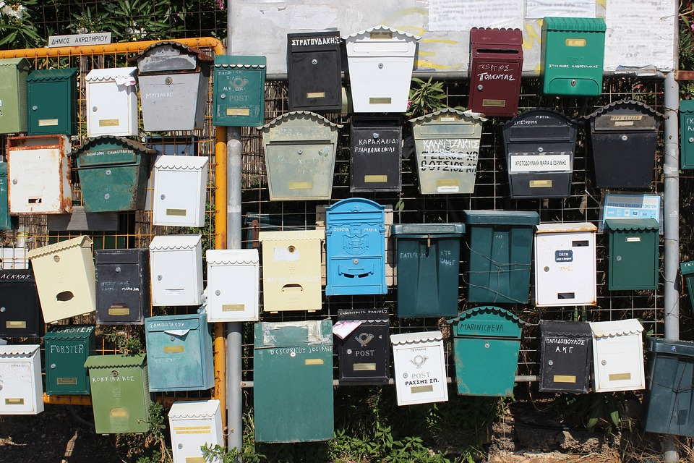
Publisher-Subscriber
https://docs.microsoft.com/en-us/azure/architecture/patterns/publisher-subscriber

Slide 42
Publisher-Subscriber

Slide 43
Publisher-Subscriber

Slide 44
Publisher-Subscriber
Notes:
->

Slide 45
Publisher-Subscriber
Notes:
->

Slide 46
Publisher-Subscriber

Slide 47
Publisher-Subscriber
Notes:
->

Slide 48
Publisher-Subscriber
Notes:
->

Slide 49
Publisher-Subscriber
Notes:
->

Slide 50
Publisher-Subscriber

Slide 51
Publisher-Subscriber
Notes:
->

Slide 52
Publisher-Subscriber
Notes:
->

Slide 53
Publisher-Subscriber

Slide 54
Publisher-Subscriber
Notes:
->

Slide 55
Publisher-Subscriber
Notes:
->

Slide 56
Publisher-Subscriber
Notes:
->

Slide 57
Publisher-Subscriber
Notes:
->

Slide 58
Publisher-Subscriber
Notes:
->

Slide 59
Publisher-Subscriber
Notes:
->

Slide 60
Publisher-Subscriber
Notes:
->

Slide 61
Publisher-Subscriber
Notes:
->

Slide 62
Publisher-Subscriber
Notes:
->

Slide 63
Publisher-Subscriber
Notes:
->

Slide 64
Publisher-Subscriber
Notes:
->

Slide 65
Publisher-Subscriber

Slide 66

Message Filter
https://www.enterpriseintegrationpatterns.com/Filter.html

Slide 67
Message Filter

Slide 68
Message Filter
A
B
A

Slide 69
Message Filter
A
B
A

Slide 70
Message Filter
A
A
B
Notes:
->

Slide 71
Message Filter
A
A
B

Slide 72
Message Filter
A
A
B
Notes:
->

Slide 73
Message Filter
A
A
B
Notes:
->

Slide 74
Message Filter
B
B
A
A
B
A

Slide 75
Message Filter
A
A
B
B
A
B

Slide 76
Message Filter
A
A
A
B
B
B
Notes:
->

Slide 77
Message Filter
A
A
A
B
B
B
Notes:
->

Slide 78
Message Filter
A
A
A
B
B
B
Notes:
->

Slide 79
Message Filter
A
A
A
B
B
B

Slide 80
Message Filter
A
A
A
B
B
B
Notes:
->

Slide 81
Message Filter
A
A
A
B
B
B

Slide 82
Message Filter
A
A
A
B
B
B
Notes:
->

Slide 83
Message Filter
A
A
A
B
B
B
Notes:
->

Slide 84
Message Filter
A
A
A
B
B
B

Slide 85
Message Filter
A
A
A
B
B
Notes:
->

Slide 86
Message Filter
A
A
A
B
B
Notes:
->

Slide 87
Message Filter
A
A
A
B
B
Notes:
->

Slide 88
Message Filter
A
A
B
B
Notes:
->

Slide 89
Message Filter
A
A
B
B
Notes:
->

Slide 90
Message Filter
A
A
B
B
Notes:
->

Slide 91
Message Filter
A
B
B
Notes:
->

Slide 92
Message Filter
A
B
B
Notes:
->

Slide 93
Message Filter
A
B
Notes:
->

Slide 94
Message Filter
A
B
Notes:
->

Slide 95
Message Filter
A
Notes:
->

Slide 96
Message Filter

Slide 97
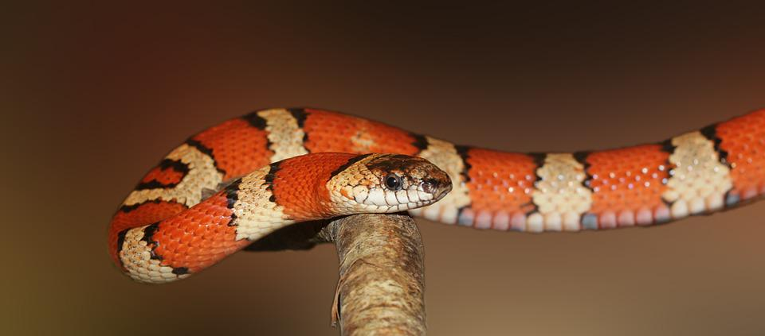
Message Poisoning
https://en.wikipedia.org/wiki/Poison_message

Slide 98
Message Poisoning

Slide 99
Message Poisoning

Slide 100
Message Poisoning

Slide 101
Message Poisoning
Notes:
->

Slide 102
Message Poisoning

Slide 103
Message Poisoning
Notes:
->

Slide 104
Message Poisoning

Slide 105
Message Poisoning
Notes:
->

Slide 106
Message Poisoning
Notes:
->

Slide 107
Message Poisoning

Slide 108
Message Poisoning

Slide 109
Message Poisoning
Notes:
->

Slide 110
Message Poisoning
Notes:
->

Slide 111
Message Poisoning

Slide 112
Message Poisoning
Notes:
->

Slide 113
Message Poisoning

Slide 114
Message Poisoning
Notes:
->

Slide 115
Message Poisoning
Notes:
->

Slide 116
Message Poisoning

Slide 117

Idempotent Receiver
https://www.enterpriseintegrationpatterns.com/IdempotentReceiver.html

Slide 118
Idempotent Receiver
1
2
3
4

Slide 119
Idempotent Receiver
4
3
2
1

Slide 120
Idempotent Receiver
1
4
3
2
Notes:
->

Slide 121
Idempotent Receiver
1
4
3
2
Notes:
->

Slide 122
Idempotent Receiver
1
4
3
2
Notes:
->

Slide 123
Idempotent Receiver
1
4
3
2

Slide 124
Idempotent Receiver
1
5
4
3
6
2
Notes:
->

Slide 125
Idempotent Receiver
1
6
5
4
3
2

Slide 126
Idempotent Receiver
6
5
4
3
2
Notes:
->

Slide 127
Idempotent Receiver
3
6
5
4
2
Notes:
->

Slide 128
Idempotent Receiver
3
6
5
4
2
Notes:
->

Slide 129
Idempotent Receiver
1
3
6
5
4
2

Slide 130
Idempotent Receiver
3
1
6
5
4
2

Slide 131
Idempotent Receiver
3
1
6
5
4
2

Slide 132
Idempotent Receiver
3
6
5
4
2

Slide 133
Idempotent Receiver
3
6
5
4
Notes:
->

Slide 134
Idempotent Receiver
3
6
5
4
Notes:
->

Slide 135
Idempotent Receiver
3
6
5
4
Notes:
->

Slide 136
Idempotent Receiver
5
6
4
Notes:
->

Slide 137
Idempotent Receiver
5
6
4
Notes:
->

Slide 138
Idempotent Receiver
5
6
Notes:
->

Slide 139
Idempotent Receiver
5
6
Notes:
->

Slide 140
Idempotent Receiver
6
Notes:
->

Slide 141
Idempotent Receiver

Slide 142

Message Scheduling
https://docs.microsoft.com/en-us/azure/service-bus-messaging/message-sequencing#scheduled-messages

Slide 143
Message Scheduling

Slide 144
Message Scheduling
Notes:
->

Slide 145
Message Scheduling
Notes:
->

Slide 146
Message Scheduling

Slide 147
Message Scheduling
5s

Slide 148
Message Scheduling
5s
Notes:
->

Slide 149
Message Scheduling
5s

Slide 150
Message Scheduling
5s
Notes:
->

Slide 151
Message Scheduling
5s
Notes:
->

Slide 152
Message Scheduling
5s
Notes:
->

Slide 153
Message Scheduling
5s

Slide 154
Message Scheduling
Notes:
->

Slide 155
Message Scheduling

Slide 156
Message Scheduling
Notes:
->

Slide 157
Message Scheduling
Notes:
->

Slide 158
Message Scheduling
Notes:
->

Slide 159
Message Scheduling
Notes:
->

Slide 160
Message Scheduling
Notes:
->

Slide 161
Message Scheduling

Slide 162

Transactional Queues
https://docs.microsoft.com/en-us/azure/service-bus-messaging/service-bus-transactions

Slide 163
Transactional Queues

Slide 164
Transactional Queues

Slide 165
Transactional Queues

Slide 166
Transactional Queues

Slide 167
Transactional Queues

Slide 168
Transactional Queues
Notes:
->

Slide 169
Transactional Queues

Slide 170
Transactional Queues
Notes:
->

Slide 171
Transactional Queues
Notes:
->

Slide 172
Transactional Queues

Slide 173
Transactional Queues
Notes:
->

Slide 174
Transactional Queues
Notes:
->

Slide 175
Transactional Queues
Notes:
->

Slide 176
Transactional Queues
Notes:
->

Slide 177
Transactional Queues
Notes:
->

Slide 178
Transactional Queues

Slide 179

Asynchronous Request-Reply
https://docs.microsoft.com/en-us/azure/architecture/patterns/async-request-reply

Slide 180
Asynchronous Request-Reply

Slide 181
Asynchronous Request-Reply

Slide 182
Asynchronous Request-Reply
Notes:
->

Slide 183
Asynchronous Request-Reply

Slide 184
Asynchronous Request-Reply

Slide 185
Asynchronous Request-Reply

Slide 186
Asynchronous Request-Reply

Slide 187
Asynchronous Request-Reply
Notes:
->

Slide 188
Asynchronous Request-Reply
Notes:
->

Slide 189
Asynchronous Request-Reply

Slide 190
Asynchronous Request-Reply
Notes:
->

Slide 191
Asynchronous Request-Reply

Slide 192
Asynchronous Request-Reply

Slide 193

Sequential Convoy
https://docs.microsoft.com/en-us/azure/architecture/patterns/sequential-convoy

Slide 194
Sequential Convoy

Slide 195
Sequential Convoy
A
C
B
C

Slide 196
Sequential Convoy
A
B
C
C

Slide 197
Sequential Convoy
A
A
B
B
C
C
A
Notes:
->

Slide 198
Sequential Convoy
A
A
A
B
B
C
C

Slide 199
Sequential Convoy
A
A
A
B
C
C
B
Notes:
->

Slide 200
Sequential Convoy
A
A
A
B
C
C
B

Slide 201
Sequential Convoy
A
A
A
B
C
C

Slide 202
Sequential Convoy
A
A
A
C
C
B

Slide 203
Sequential Convoy
A
A
C
C
B
Notes:
->

Slide 204
Sequential Convoy
A
A
C
C
B
Notes:
->

Slide 205
Sequential Convoy
A
A
C
C
B
Notes:
->

Slide 206
Sequential Convoy
A
A
C
C

Slide 207
Sequential Convoy
A
A
C
C
Notes:
->

Slide 208
Sequential Convoy
A
A
C
C
Notes:
->

Slide 209
Sequential Convoy
A
C
C
Notes:
->

Slide 210
Sequential Convoy
A
C
C
Notes:
->

Slide 211
Sequential Convoy
A
C
Notes:
->

Slide 212
Sequential Convoy
A
C
Notes:
->

Slide 213
Sequential Convoy
A
Notes:
->

Slide 214
Sequential Convoy

Slide 215
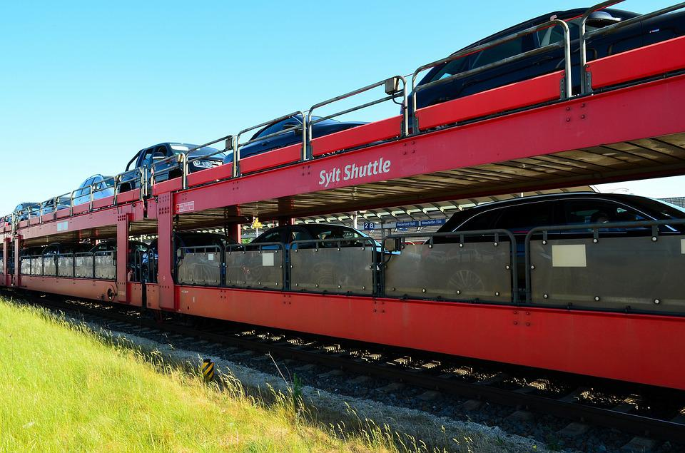
Claim Check
https://docs.microsoft.com/en-us/azure/architecture/patterns/claim-check

Slide 216


Claim Check

Slide 217
Claim Check

Slide 218
Claim Check

Slide 219

Claim Check

Slide 220
Claim Check
Notes:
->

Slide 221
Claim Check

Slide 222
Claim Check

Slide 223
Claim Check
Notes:
->

Slide 224
Claim Check

Slide 225
Claim Check

Slide 226
Claim Check
Notes:
->

Slide 227
Claim Check

Slide 228
Claim Check

Slide 229
Claim Check

Slide 230
Claim Check

Slide 231

Exactly Once Processing
https://www.cloudcomputingpatterns.org/exactly_once_delivery/

Slide 232

Exactly Once Processing

Slide 233
Exactly Once Processing
1
Notes:
->

Slide 234
Exactly Once Processing
1
Notes:
->

Slide 235
Exactly Once Processing
2
1
Notes:
->

Slide 236
Exactly Once Processing
2
1
Notes:
->

Slide 237
Exactly Once Processing
2
1
Notes:
->

Slide 238
Exactly Once Processing
2
1

Slide 239
Exactly Once Processing
2
1
Notes:
->

Slide 240
Exactly Once Processing
3
2
1
Notes:
->

Slide 241
Exactly Once Processing
3
2
1
Notes:
->

Slide 242
Exactly Once Processing
3
2
Notes:
->

Slide 243
Exactly Once Processing
3
2
Notes:
->

Slide 244
Exactly Once Processing
3
2
Notes:
->

Slide 245
Exactly Once Processing
3
2
Notes:
->

Slide 246
Exactly Once Processing
1
3
2

Slide 247
Exactly Once Processing
1
3
2
Notes:
->

Slide 248
Exactly Once Processing
1
3
2

Slide 249
Exactly Once Processing
3
2

Slide 250
Exactly Once Processing
3
2
2

Slide 251
Exactly Once Processing
3
2
Notes:
->

Slide 252
Exactly Once Processing
3
2
Notes:
->

Slide 253
Exactly Once Processing
3
2

Slide 254
Exactly Once Processing
3
Notes:
->

Slide 255
Exactly Once Processing
3
Notes:
->

Slide 256
Exactly Once Processing
3
Notes:
->

Slide 257
Exactly Once Processing
3
Notes:
->

Slide 258
Exactly Once Processing

Slide 259
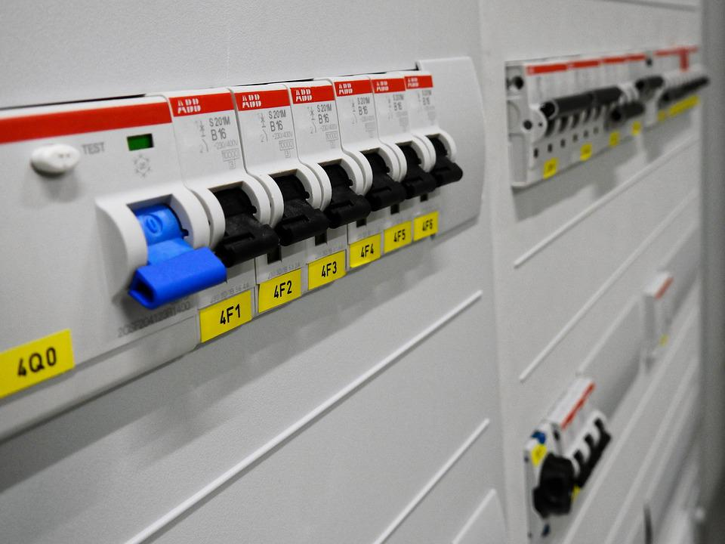
Circuit Breaker
https://docs.microsoft.com/en-us/azure/architecture/patterns/circuit-breaker

Slide 260


Circuit Breaker

Slide 261
Circuit Breaker
Notes:
->

Slide 262
Circuit Breaker
Notes:
->

Slide 263
Circuit Breaker
Notes:
->

Slide 264
Circuit Breaker
Notes:
->

Slide 265
Circuit Breaker
Notes:
->

Slide 266
Circuit Breaker
Notes:
->

Slide 267
Circuit Breaker
Notes:
->

Slide 268
Circuit Breaker
Notes:
->

Slide 269
Circuit Breaker

Slide 270
Circuit Breaker

Slide 271
Circuit Breaker
Notes:
$q.Status = "ReceiveDisabled"
Set-AzServiceBusQueue -ResourceGroup mygrp -NamespaceName myns -QueueName myqueue -QueueObj $q

Slide 272
Circuit Breaker
Notes:
->

Slide 273
Circuit Breaker

Slide 274
Circuit Breaker
Notes:
->

Slide 275
Circuit Breaker
Notes:
->

Slide 276
Circuit Breaker

Slide 277
Circuit Breaker
Notes:
->

Slide 278
Circuit Breaker

Slide 279
Circuit Breaker

Slide 280
Circuit Breaker
Notes:
->

Slide 281
Circuit Breaker
Notes:
->

Slide 282
Circuit Breaker
Notes:
->

Slide 283
Circuit Breaker
Notes:
->

Slide 284
Circuit Breaker
Notes:
->

Slide 285
Circuit Breaker
Notes:
->

Slide 286
Circuit Breaker
Notes:
->

Slide 287
Circuit Breaker
Notes:
->

Slide 288
Circuit Breaker
Notes:
->

Slide 289
Circuit Breaker
Notes:
->

Slide 290
Circuit Breaker
Notes:
->

Slide 291
Circuit Breaker
Notes:
->

Slide 292
Circuit Breaker
Notes:
->

Slide 293
Circuit Breaker
Notes:
->

Slide 294
Circuit Breaker
Notes:
->

Slide 295
Circuit Breaker

Slide 296
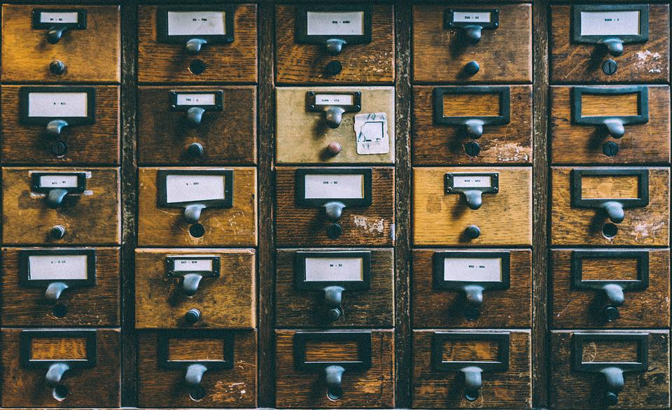
Transactional Outbox
https://docs.microsoft.com/en-us/azure/architecture/best-practices/transactional-outbox-cosmos

Slide 297

Transactional Outbox

Slide 298
Transactional Outbox
Notes:
->

Slide 299
Transactional Outbox

Slide 300
Transactional Outbox
Notes:
->

Slide 301
Transactional Outbox

Slide 302
Transactional Outbox

Slide 303
Transactional Outbox
Notes:
->

Slide 304
Transactional Outbox
Notes:
->

Slide 305
Transactional Outbox
Notes:
->

Slide 306
Transactional Outbox

Slide 307
Transactional Outbox

Slide 308
Transactional Outbox

Slide 309
Transactional Outbox
1

Slide 310
Transactional Outbox
1
2
Notes:
->

Slide 311
Transactional Outbox
2
1
Notes:
->

Slide 312
Transactional Outbox
2
1
Notes:
->

Slide 313
Transactional Outbox
2
1
Notes:
->

Slide 314
Transactional Outbox
2
1
Notes:
->

Slide 315
Transactional Outbox
2
1
Notes:
->

Slide 316
Transactional Outbox
2
Notes:
->

Slide 317
Transactional Outbox
2
Notes:
->

Slide 318
Transactional Outbox

Slide 319
Transactional Outbox

Slide 320
Transactional Outbox
2
Notes:
->

Slide 321
Transactional Outbox
2
Notes:
->

Slide 322
Transactional Outbox
2

Slide 323
Transactional Outbox
2

Slide 324
Transactional Outbox

Slide 325

Saga
https://weblogs.asp.net/sfeldman/sagas-with-azure-service-bus

Slide 326
Saga

Slide 327
Saga
12
Notes:
->

Slide 328
Saga
12
Notes:
->

Slide 329
Saga
12

Slide 330
Saga
34
12
Notes:
->

Slide 331
Saga
12
34
Notes:
->

Slide 332
Saga
12
34

Slide 333
Saga
12
34
34
Notes:
->

Slide 334
Saga
12
34
34
Notes:
->

Slide 335
Saga
12
34
34

Slide 336
Saga
12
34
34
Notes:
->

Slide 337
Saga
12
34
34
Notes:
->

Slide 338
Saga
12
34
34

Slide 339
Saga
12
34
12
34
Notes:
->

Slide 340
Saga
12
12
34
34
Notes:
->

Slide 341
Saga
12
12
34
34

Slide 342
Saga
12
12
34
Notes:
->

Slide 343
Saga
12
12
34
Notes:
->

Slide 344
Saga
12
12

Slide 345
Saga
56
12
12
Notes:
->

Slide 346
Saga
56
12
12
56

Slide 347
Saga
56
12
12
56
Notes:
->

Slide 348
Saga
12
12
56
56
Notes:
->

Slide 349
Saga
12
12
56
56

Slide 350
Saga
12
56
56
Notes:
->

Slide 351
Saga
12
56
56

Slide 352
Saga
78
12
56
56
Notes:
->

Slide 353
Saga
12
78
56
56
Notes:
->

Slide 354
Saga
78
12
56
56

Slide 355
Saga
78
56
56
Notes:
->

Slide 356
Saga
78
56
56
Notes:
->

Slide 357
Saga
78
56
Notes:
->

Slide 358
Saga
78
56
Notes:
->

Slide 359
Saga
78
Notes:
->

Slide 360
Saga
Notes:
->

Slide 361

Saga

Slide 362
Saga

Slide 363
Saga

Slide 364

Almost done…

Slide 365
Key take-aways
Messaging patterns allow to solve recurring challenges
Azure Service Bus offers a variety of features to implement these patterns
Complement with other Azure services

Slide 366




Thank You
@egrootenboer
servicebuspm@microsoft.com
https://www.linkedin.com/in/eldert-grootenboer
https://aka.ms/MessagingFeedbackDWX

Slide 367



Thank you!
@borzenko_lena
olena-borzenko
borzenko.olena
@egrootenboer
eldert-grootenboer
eldert.grootenboer
Notes:
O + E

